Slide 1
Constructing Intermediate Reports

Slide 2
Never Having to Say “I’m Sorry”
Users can be particular about the way their reports are laid out. In many cases, you will be creating new reports to replace existing ones.
It may be that the user was getting a report from a legacy system, from an Access report or a spreadsheet, or from a ledger book.
Whatever the case, the user is used to seeing the data presented in a certain way, with everything arranged just so.
What the users don’t want to hear is, “I’m sorry, but we can’t do it that way in Reporting Services.”

Slide 3
The Report Template
Features Highlighted
Creating a reusable template for reports
Using values from the Built-in Fields collection
Business Need - Galactic Delivery Services (GDS) is looking to increase the efficiency of its report developers. GDS would like a template that can be used for each new report created. The report template is to include the GDS logo and the company name in a header across the top of each page. The template is also to include a footer across the bottom of each page showing the date and time the report was printed, who printed the report, the current page number, and the total number of pages in the report.
Task Overview
Create the Template Project and the Template Report with a Page Header.
Create the Page Footer on the Template Report.
Copy the Template to the Report Project Directory.

Slide 4
Exercise 1
Report Template, Task 1: Create the Template Project and the Template Report with a Page Header
Create a new Reporting Services project called Template in the MSSQLRS folder.
Add a blank report called GDSReport to the Template project.
From the main menu, select Report | Add Page Header. A space for the page header layout appears at the top part of the design surface.
From the Toolbox, place an image item in the layout area for the page header. The Image Properties dialog box appears.
Click the Import button. The Open dialog box appears.
Select GIF files from the Files of type drop-down list.
Navigate to the GDS.gif image file and select it. Click Open.
Click OK to exit the Image Properties dialog box. The image is embedded in the report and used by the image report item you placed in the page header.

Slide 5
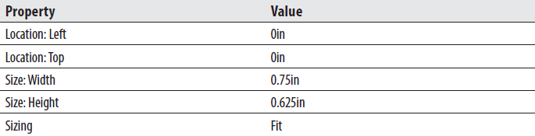
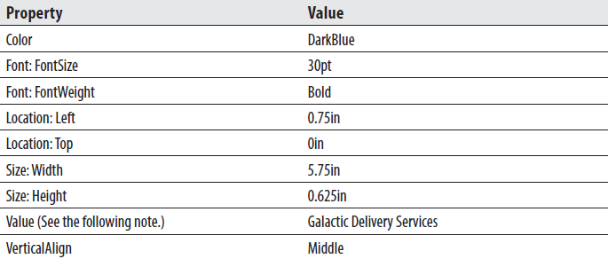
Exercise 1
Report Template, Task 1: Create the Template Project and the Template Report with a Page Header
Modify the following properties of the image:
Place a text box in the layout area for the page header. Modify the following properties of the text box:
Click in the page header layout area outside the text box and image. Page Header is selected in the drop-down list at the top of the Properties window.

Slide 6
Exercise 1
Report Template, Task 1: Create the Template Project and the Template Report with a Page Header
Modify the following property for the page header:
Reporting Services reports have a page header layout area that can be used to create a page heading for the report.
The page header has properties, so it can be turned off on the first page or the last page of the report. Aside from these options, if the page header is turned on in the Report menu, it appears on each report page.
The page header can be populated with images, text boxes, lines, and rectangles.
You cannot, however, place any data regions, tables, matrixes, lists, or charts in a page header.
You can place a text box that references a field from a dataset in the page header.
As with any other field expression placed outside of a data region, the value will not change from page to page.

Slide 7
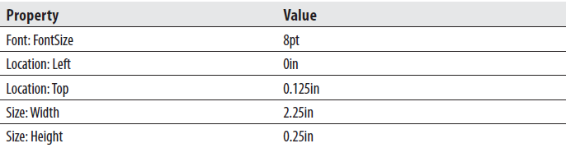
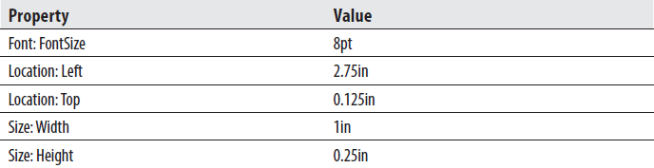
Exercise 1
Report Template, Task 2: Create the Page Footer on the Template Report
Click anywhere on the design surface.
From the main menu, select Report | Add Page Footer. A space for the page footer layout appears below the layout area for the body of the report.
In the Report Data window, expand the Built-in Fields entry. Select ReportName and drag it onto the page footer layout area.
Modify the following properties of the text box that results:
Place a text box in the layout area for the page footer. Modify the following properties of the text box:

Slide 8
Exercise 1
Report Template, Task 2: Create the Page Footer on the Template Report
Right-click this text box and select Expression from the context menu. The Expression dialog box appears.
Type the following in the Set expression for: Value area after the equals (=) sign:
"Page " &
A space should be typed both before and after the ampersand character (&).
Select Built-in Fields in the Category pane.
Double-click PageNumber in the Item pane to append it to the expression. The expression to return PageNumber from the Globals collection is added to the Expression area. (Globals and Built-in Fields are two different names for the same group of items.)
After the PageNumber expression, type the following:
& " of " &
A space should be typed both before and after each ampersand.
Double-click TotalPages in the Item pane. The expression to return TotalPages from the Globals collection is added to the Expression area.

Slide 9
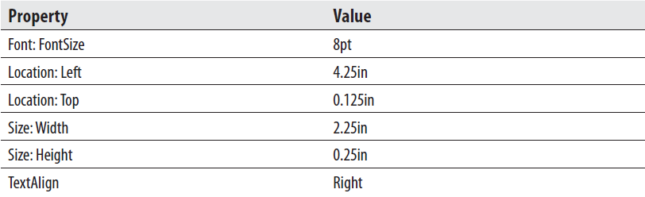

Exercise 1
Report Template, Task 2: Create the Page Footer on the Template Report
Click OK to exit the Expression dialog box.
In the Report Data window, select ExecutionTime and drag it onto the page footer layout area.
Modify the following properties of the text box that results:
Click in the page footer layout area outside of the three text boxes so Page Footer is selected in the Properties window. Modify the following property of the page footer:

Slide 10
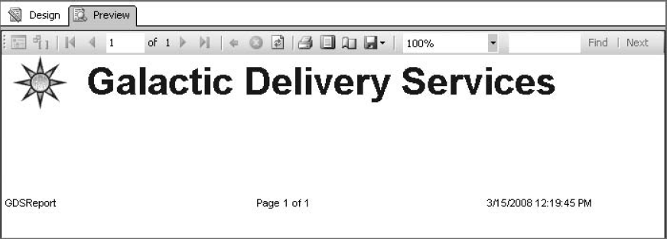
Exercise 1
Report Template, Task 2: Create the Page Footer on the Template Report
Your report layout should appear similar to figure below.
Click the Preview tab. Your report should appear similar to figure below.

Slide 11
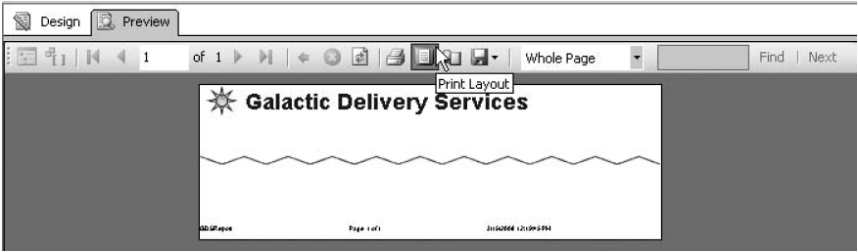
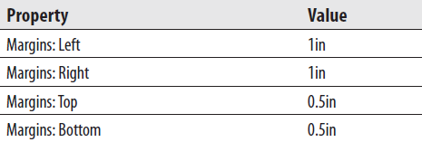
Exercise 1
Report Template, Task 2: Create the Page Footer on the Template Report
For a better look at what the header and footer will look like on a printed report, click the Print Layout button, as shown in figure below.
Finally, let’s set the margins for the report. Click the Design tab.
In the main menu, select Report | Report Properties. The Report Properties dialog box appears.
Modify the following values:

Slide 12
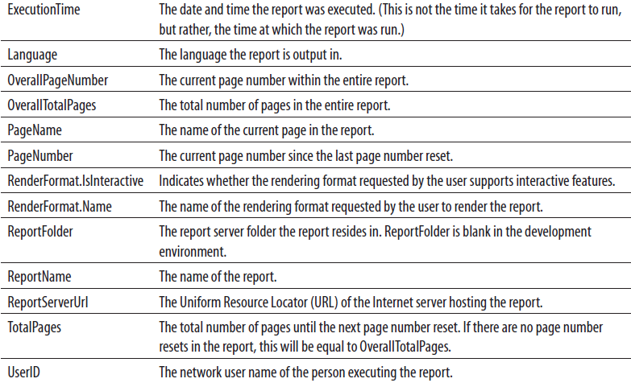
Exercise 1
Report Template, Task 2: Create the Page Footer on the Template Report
Click OK to exit the Report Properties dialog box.
Click the Preview tab. The header and footer should appear to be positioned better on the page.
Click the Print Layout button to exit the print layout mode.
Click Save All on the toolbar.
Reporting Services provides a number of global or built-in fields you can use in your reports, including the following:

Slide 13
Exercise 1
Report Template, Task 3: Copy the Template to the Report Project Directory
From the main menu, select File | Close Project to close the project and its associated solution.
Open Windows Explorer and navigate to the folder you created for the Template project. From the My Documents folder, the path should be the following:
Visual Studio 2010\Projects\MSSQLRS\Template
In the Template folder, highlight the file GDSReport.rdl. This is the template report we just created. Make sure you highlight GDSReport.rdl and not GDSReport.rdl.data.
Press ctrl-c to copy this file.
Navigate to the directory where the Report Designer stores its templates. In a default installation, this is:
C:\Program Files\Microsoft Visual Studio 10.0\Common7\IDE\
PrivateAssemblies\ProjectItems\ReportProject
Select the ReportProject folder.
Press ctrl-v to paste the copied file in this directory.
Close Windows Explorer.

Slide 14
The Employee Time Report
Features Highlighted
Using a report template
Putting totals in headers and footers
Using scope to affect aggregate function results
Toggling visibility
Business Need - The Galactic Delivery Services personnel department needs a report showing the amount of time entered by its employees on their weekly timesheets. The report should group the time by job, employee, and week, with totals presented for each grouping. The groups should be collapsed initially, and the user should be able to drill down into the desired group. Group totals should be visible even when the group is collapsed.
Task Overview
Create a New Report, and a New Dataset.
Populate the Report Layout.
Add Drilldown Capability.
Add Totalling.

Slide 15
Exercise 2
Employee Time Report, Task 1: Create the Chapter07 Project, a Shared Data Source, a New Report, and a Dataset
Create a new Reporting Services project called Chapter08 in the MSSQLRS folder.
Create a shared data source called Galactic for the Galactic database.
Right-click Reports in the Solution Explorer. Select Add | New Item from the context menu. The Add New Item dialog box appears.
Single-click GDSReport in the Templates area to select it. Change the Name to EmployeeTime and click Add.
Create a data source called “Galactic” in this new report. This new data source should reference the Galactic shared data source.

Slide 16
Exercise 2
Employee Time Report, Task 1: Create the Chapter07 Project, a Shared Data Source, a New Report, and a Dataset
Create a dataset called “EmployeeTime” with the following query:
SELECT Description AS Job,
Employee.EmployeeNumber,
FirstName,
LastName,
CONVERT(char(4),DATEPART(yy, WorkDate))+'-'+
CONVERT(char(2),DATEPART(wk, WorkDate)) AS Week,
WorkDate,
HoursWorked
FROM TimeEntry
INNER JOIN Assignment
ON TimeEntry.AssignmentID = Assignment.AssignmentID
INNER JOIN Employee
ON Assignment.EmployeeNumber = Employee.EmployeeNumber
INNER JOIN Job
ON Assignment.JobID = Job.JobID
ORDER BY Job, Employee.EmployeeNumber, Week, WorkDate

Slide 17
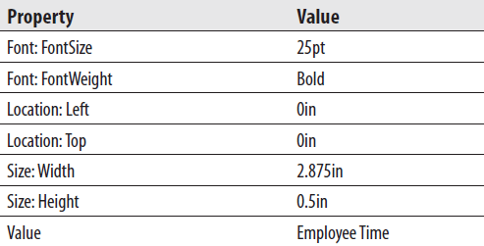
Exercise 2
Employee Time Report, Task 2: Populate the Report Layout
Place a text box onto the body of the report. Modify the following properties of this text box:
Use the table template from the Toolbox to place a tablix onto the body of the report immediately below the text box you just added.
In the Report Data window, drag the WorkDate field into the data row in the center column of the tablix.
Drag the HoursWorked field into the data row in the right-hand column of the table.
Select the entire header row in the tablix. Modify the following property:

Slide 18
Exercise 2
Employee Time Report, Task 2: Populate the Report Layout
Right-click anywhere in the lower row of the tablix and hover over the Add Group item in the Tablix area of the context menu. Select the Parent Group item from the Row Group area of the submenu. The Tablix group dialog box appears.
Select [Week] from the Group by drop-down list.
Check the Add group header check box and the Add group footer check box.
Click OK to exit the Tablix group dialog box.
Right-click the cell containing the [Week] field and select Tablix: Add Group | Row Group: Parent Group from the context menu. The Tablix group dialog box appears.
Select [EmployeeNumber] from the Group by drop-down list.
Check the Add group header check box and the Add group footer check box.
Click OK to exit the Tablix group dialog box.
Right-click the cell containing the [EmployeeNumber] field and select Tablix: Add Group | Row Group: Parent Group from the context menu. The Tablix group dialog box appears.

Slide 19
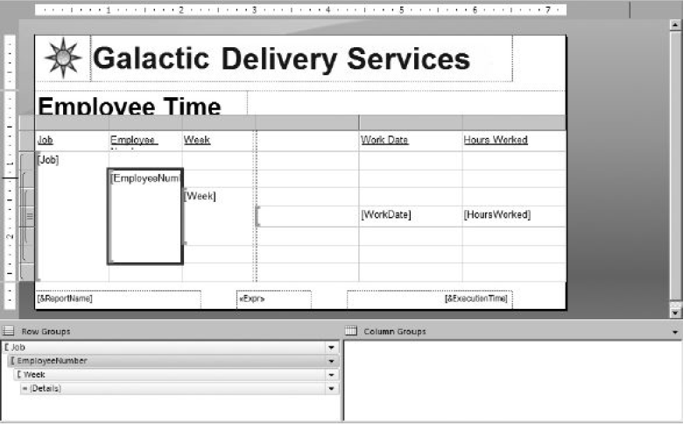
Exercise 2
Employee Time Report, Task 2: Populate the Report Layout
Select [ Job] from the Group by drop-down list.
Check the Add group header check box and the Add group footer check box.
Click OK to exit the Tablix group dialog box. The report layout should appear as shown in figure below.

Slide 20
Exercise 2
Employee Time Report, Task 2: Populate the Report Layout
In addition to the header and footer rows for each group, we have a header column for each group. These are the columns to the left of the double dashed line. Click the gray rectangle above the Group3 column and hold down the mouse button. Drag the mouse pointer to the gray rectangle above the Group1 column and release the mouse button. All three group columns to the left of the double dashed lines should be selected.
Right-click in the gray rectangle above the Group1 column and select Delete Columns from the context menu. This deletes the grouping columns, but it does not delete the groups or the group header and footer rows.
The symbols in the gray boxes to the left of the tablix identify the three groupings and the detail row. The detail row has the gray box with the three horizontal lines. Immediately above the detail row is the header for the innermost group. The innermost group is the Week group. The innermost group is surrounded by the header and footer for the middle group, which is the Employee group.

Slide 21
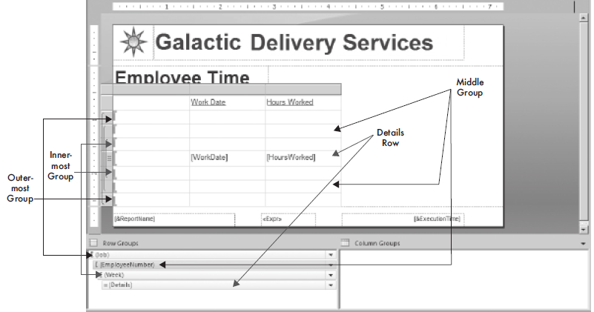
Exercise 2
Employee Time Report, Task 2: Populate the Report Layout
The middle group is surrounded by the header and footer for the outermost group, which is the Job group. At the very top of the tablix is a tablix header row for column headings (see figure below). Hover over the leftmost cell in the top group header row. Select the Job field from the Field Selector.

Slide 22
Exercise 2
Employee Time Report, Task 2: Populate the Report Layout
Modify the following property of this cell:
Right-click anywhere in the leftmost column in the table. Select Tablix: Insert Column | Right from the context menu.
Hover over the cell in the middle group header row in the column you just created. Select the EmployeeNumber field from the Field Selector.
Modify the following property of this cell:
Drag the width of the leftmost column in the table until the column is just wide enough for the word “Job” in the table header cell.

Slide 23
Exercise 2
Employee Time Report, Task 2: Populate the Report Layout
Select the two leftmost cells in the row for the outermost group header, rightclick and select Tablix: Merge Cells from the context menu.
Right-click anywhere in the second-from-the-left column in the table. Select Tablix: Insert Column | Right from the context menu.
Hover over the cell in the column you just created in the innermost group header row. Select the Week field from the Field Selector.
Modify the following property of this cell:
Drag the width of the second column from the left until it is just wide enough for the words “Employee Number” in the tablix header cell.
Drag the width of the third column from the left until it is about twice as wide as the word “Week” in the tablix header cell.
Drag the width of the fourth column from the left until it is about twice as wide as the words “Work Date” in the tablix header cell.

Slide 24
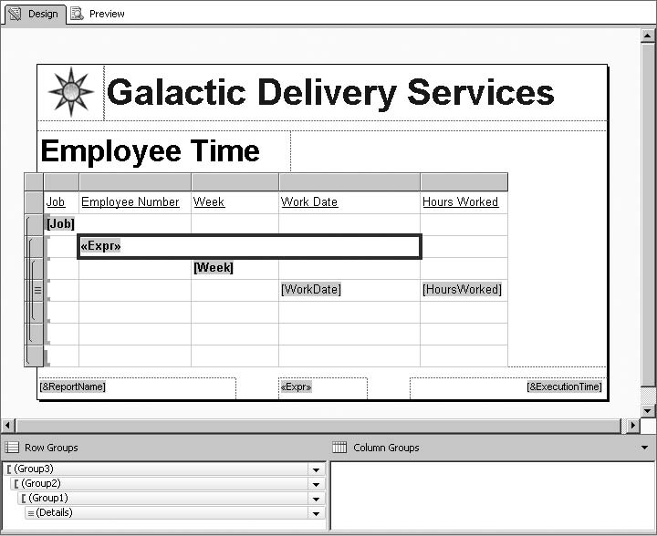
Exercise 2
Employee Time Report, Task 2: Populate the Report Layout
Select the cell containing “[Sum(EmployeeNumber)]”. In addition, select the two cells to the right of this cell. Right-click this group of cells and select Tablix: Merge Cells from the context menu.
Modify the value of the merged cell that results from Step 33. Select Expression from the drop-down list to make editing easier. Set the value to the following:
=Fields!EmployeeNumber.Value & "-" &
Fields!FirstName.Value & " " & Fields!LastName.Value
Click OK to exit the Expression dialog box. Your report layout should appear similar to figure below.
Click the Preview tab.

Slide 25
Exercise 2
Employee Time Report, Task 3: Add Drilldown Capability
Click the Design tab.
Using the drop-down menu for EmployeeNumber in the Row Groups pane, select Group Properties. The Group Properties dialog box appears.
Select the Visibility page.
Select the Hide radio button under the When the report is initially run: prompt.
Check the Display can be toggled by this report item check box.
Select Job from the drop-down list immediately below this check box.
Click OK to exit the Group Properties dialog box.
Using the drop-down menu for Group1 in the Row Groups pane, select Group Properties. The Group Properties dialog box appears.
Select the Visibility page.
Select the Hide radio button under the When the report is initially run: prompt.
Check the Display can be toggled by this report item check box.

Slide 26
Exercise 2
Employee Time Report, Task 3: Add Drilldown Capability
Select EmployeeNumber from the drop-down list immediately below this check box.
Click OK to exit the Group Properties dialog box.
Using the drop-down menu for the Details group in the Row Groups pane, select Group Properties. The Group Properties dialog box appears.
Select the Visibility page.
Select the Hide radio button under the When the report is initially run: prompt.
Check the Display can be toggled by this report item check box.
Select Week from the drop-down list immediately below this check box.
Click OK to exit the Group Properties dialog box.
Click the Preview tab.

Slide 27
Exercise 2
Employee Time Report, Task 4: Add Totaling
Click the Design tab.
Right-click the rightmost cell in the header row for the outermost group (the Job group) and select Textbox: Text Box Properties from the context menu. The Text Box Properties dialog box appears.
Type the following for Value:
=Sum(Fields!HoursWorked.Value)
Select the Visibility page of the dialog box.
Check the Display can be toggled by this report item check box.
Select Job from the drop-down list immediately below this check box. (We are leaving the Show radio button selected.)
Click OK to exit the Text Box Properties dialog box.
Right-click the rightmost cell in the header row for the middle group (the Employee group) and select Textbox: Text Box Properties from the context menu. The Text Box Properties dialog box appears.

Slide 28
Exercise 2
Employee Time Report, Task 4: Add Totaling
Type the following for Value:
=Sum(Fields!HoursWorked.Value)
Select the Visibility page of the dialog box.
Check the Display can be toggled by this report item check box.
Select EmployeeNumber from the drop-down list immediately below this check box. (We are leaving the Show radio button selected.)
Click OK to exit the Text Box Properties dialog box.
Right-click the rightmost cell in the header row for the innermost group (the Week group) and select Textbox: Text Box Properties from the context menu. The
Text Box Properties dialog box appears.
Type the following for Value:
=Sum(Fields!HoursWorked.Value)
Select the Visibility page of the dialog box.
Check the Display can be toggled by this report item check box.

Slide 29



Exercise 2
Employee Time Report, Task 4: Add Totaling
Select Week from the drop-down list immediately below this check box.
Click OK to exit the Text Box Properties dialog box.
Click the gray square for the footer row of the outermost group. Modify the following properties for this footer row using the Properties window:
Click the gray square for the footer row of the middle group. Modify the following properties for this footer row using the Properties window:
Click the gray square for the footer row of the innermost group. Modify the following properties for this footer row using the Properties window:

Slide 30
Exercise 2
Employee Time Report, Task 4: Add Totalling
Select the rightmost cell in the footer row of the innermost group. Modify the following properties for this text box using the Properties window:
Repeat Step 23 for the rightmost cell in the footer row of the middle group.
Repeat Step 23 for the rightmost cell in the footer row of the outermost group.
Right-click anywhere in the last row of the tablix and select Tablix: Insert Row | Outside Group - Below from the context menu. A row that will serve as a tablix footer row is added.

Slide 31
Exercise 2
Employee Time Report, Task 4: Add Totalling
Select the rightmost cell in this new tablix footer row. Modify the following properties for this text box using the Properties window:
Click the Preview tab.
Click Save All on the toolbar.

Slide 32
Data Caching During Preview
We switched between layout and preview a number of times during the development of the Employee Time report.
If you were to look on your SQL Server, however, you would find the rather complex query that provides the data for this report was only executed once.
This is because the data returned for the dataset the first time the report was run is stored in a cache file. Any time after that, when the same report is run in the Report Designer with the same query, same parameters, and same data access credentials, the cached data is used.
This data caching helps to make your report development sessions more efficient. Even if you have a report based on a query that takes a fair amount of time to run, you only have to wait for it once.
Any time you preview the report after that, the data is pulled from the cache file with no delay. This caching process also substantially decreases the load on your SQL server.

Slide 33
Data Caching During Preview
The drawback to the data-caching process comes when you are making changes to the data at the same time you are developing a report.
If you insert new records or update existing records after the first time you preview the report, and then expect to see those changes in your report the next time you preview it, you are going to be confused, disappointed, or perhaps both.
The report is rendered from the cached data that does not include the changes. To remedy this situation, click the Refresh toolbar button.
This will cause the Report Builder to re-run the queries in the report and create a new cache file. The cache file is in the same folder as the report definition file and has the same name, with a .data on the end.
Remember, this data-caching process is only used by the Report Builder during report development. A different data-caching scheme operates on the report server after the report has been put into production.

Slide 34
The Employee List Report
Features Highlighted
Implementing user-selectable grouping
Implementing interactive sorting
Using explicit page breaks
Using a floating header
Business Need - The Galactic Delivery Services personnel department wants a flexible report for listing employee information. Rather than having a number of reports for each of their separate grouping and sorting needs, they want a single report where they can choose the grouping and sort order each time the report is run. The report should be able to group on job, hub, or city of residence. The report should be able to sort by employee number, last name, or hire date. Also, each new group should start on a new page. The header information should remain visible even when the user scrolls down the report page.
Task Overview
Create a New Report and a Dataset.
Create the Report Layout.
Add Interactive Sorting and a Floating Header.

Slide 35
Exercise 3
Employee List Report, Task 1: Create a New Report and a Dataset
Reopen the Chapter08 project, if it was closed. Close the EmployeeTime report, if it is still open.
Right-click Reports in the Solution Explorer and select Add | New Item from the context menu. The Add New Item - Chapter08 dialog box appears.
Single-click GDSReport in the Templates area to select it. Change the name to EmployeeList and click Add.
Create a data source called “Galactic” in this new report. This new data source should reference the Galactic shared data source.
Create a dataset called “Employees” with the following query:
SELECT Job.Description AS Job, Hub.Description AS Hub, Employee.EmployeeNumber, FirstName, LastName, Address1, City, State,
ZipCode, HireDate, HighestLevelOfEducation, UnionMembership
FROM Employee
INNER JOIN Assignment
ON Employee.EmployeeNumber = Assignment.EmployeeNumber
INNER JOIN Job
ON Assignment.JobID = Job.JobID
INNER JOIN Hub
ON Assignment.HubCode = Hub.HubCode

Slide 36
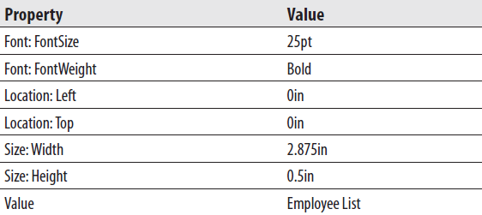
Exercise 3
Employee List Report, Task 2: Create the Report Layout
Place a text box onto the body of the report. Modify the following properties of this text box:
Use the table template to place a tablix onto the body of the report immediately below the text box you just added.
Hover over the leftmost field in the data row of the tablix and select the EmployeeNumber field from the Field Selector.
Select the FirstName field in the middle cell in the data row of the tablix.
Select the LastName field in the rightmost cell in the data row of the tablix.
Drag the Address1 field from the Report Data window onto the right edge of the tablix. This will create a new column in the tablix.

Slide 37
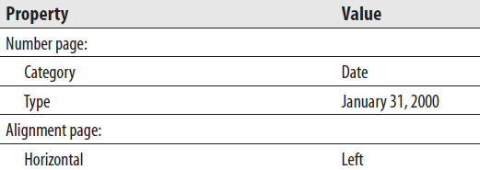
Exercise 3
Employee List Report, Task 2: Create the Report Layout
Repeat Step 6 for the City, State, ZipCode, HireDate, HighestLevelOfEducation, and UnionMembership fields. As the tablix grows wider, the report body will also grow wider to accommodate it.
Right-click the cell in the detail row containing the HireDate and select Textbox: Text Box Properties from the context menu. The Text Box Properties dialog box appears.
Modify the following properties:
Click OK to exit the Text Box Properties dialog box.
Size each column appropriately. Use the Preview tab to check your work. Continue switching between the Design tab and the Preview tab until you have the table columns sized correctly.
Drag the right edge of the report body layout area until it is just touching the right side of the tablix.

Slide 38

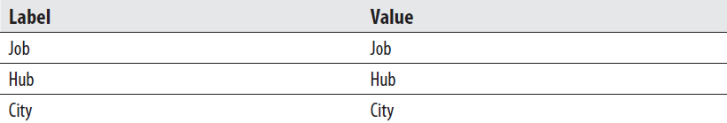
Exercise 3
Employee List Report, Task 2: Create the Report Layout
Click the gray square for the table header row to select the entire row. Modify the following property:
In the Report Data window, right-click the Parameters entry and select Add Parameter from the context menu. The Report Parameter Properties dialog box appears.
Type GroupOrder for Name and Group By for Prompt.
Select the Available Values page.
Select the Specify values radio button.
Add the following items to the list.
Select the Default Values page.
Select the Specify values radio button.

Slide 39

Exercise 3
Employee List Report, Task 2: Create the Report Layout
Add the following item to the list. (Click Add to create a new entry.)
Click OK to exit the Report Parameter Properties dialog box.
Right-click in the gray square in the upper-right corner of the tablix and select Tablix Properties from the context menu. The Tablix Properties dialog box appears.
In the Column Headers section of the General page, check the Repeat header rows on each page check box.
Click OK to exit the Tablix Properties dialog box.
Right-click anywhere in the detail row of the tablix and select Tablix: Add Group | Row Group: Parent Group. The Tablix group dialog box appears.
Click the fx button. The Expression dialog box appears.

Slide 40
Exercise 3
Employee List Report, Task 2: Create the Report Layout
Type the following in the Set expression for: GroupExpression area:
= IIF(Parameters!GroupOrder.Value = "Job", Fields!Job.Value,
IIF(Parameters!GroupOrder.Value = "Hub", Fields!Hub.Value,
Fields!City.Value))
Highlight the entire expression you just entered and press ctrl-c to copy this text.
Click OK to exit the Expression dialog box.
Check the Add group header check box.
Click OK to exit the Tablix group dialog box.
In the Row Groups pane, use the drop-down menu for Group1 to select Group Properties. The Group Properties dialog box appears.
Select the Page Breaks page.
Check the Between each instance of a group check box.
Select the Sorting page.

Slide 41
Exercise 3
Employee List Report, Task 2: Create the Report Layout
Click the fx button. The Expression dialog box appears. Note the tablix is automatically set to sort by our grouping expression.
Click OK to exit the Expression dialog box.
Leave the Order set to “A to Z.” Click OK to exit the Group Properties dialog box.
In the Row Groups pane, use the drop-down menu for Details to select Group Properties. The Group Properties dialog box appears.
Select the Sorting page.
Click Add to create a new sorting entry.
Select [EmployeeNumber] from the Sort by drop-down list.
Leave the Order set to “A to Z.” Click OK to exit the Group Properties dialog box.
Click the cell containing the “<<Expr>>” expression placeholder. Press delete to remove the text box in this cell. Repeat this with the cell containing the “Group1” heading. Size the leftmost column so it is as narrow as possible.
Right-click the cell containing the [EmployeeNum] placeholder and select Tablix: Insert Column | Left.

Slide 42
Exercise 3
Employee List Report, Task 2: Create the Report Layout
Right-click the detail row of this new column and select Tablix: Add Group | Column Group: Parent Group. The Tablix group dialog box appears.
Enter =1 for Group by and check the Add group header check box. Click OK to exit the Tablix group dialog box.
Click the cell containing the “<<Expr>>” expression placeholder. Press delete to remove the text box in this cell. Size the two leftmost columns so they are as narrow as possible.
Select the three cells in the group header row under EmployeeNumber, FirstName, and LastName. (This is the third row from the top in the tablix.)
Right-click these cells, and select Tablix: Merge Cells from the context menu.Right-click these cells again and select Textbox: Expression from the context menu. The Expression dialog box appears.
Delete the equals sign from the Set expression for: Value area and press ctrl-v to paste the expression into the Expression area. This should be the same expression you entered in Step 28.
Click OK to exit the Expression dialog box.

Slide 43
Exercise 3
Employee List Report, Task 2: Create the Report Layout
Modify the following property of the merged cells:
Click the text box containing the Employee Number header (only the “Employee” portion may be visible) and hold down the mouse button. Drag the mouse pointer over to the text box containing the Union Membership header. This will select all of the header text boxes.
Press ctrl-x to cut these text boxes.
Press up arrow to select a text box in the top row of the tablix.
Press ctrl-v to paste the header text boxes in the top row of the tablix.
Right-click the gray box to the right of the empty row (the row from which we just removed the header text boxes) and select Delete Rows from the context menu. Click the Preview tab.
Experiment with changing the grouping. Remember to click View Report each time to refresh the report.
Click Save All on the toolbar.

Slide 44
Exercise 3
Employee List Report, Task 3: Add Interactive Sorting and a Floating Header
Click the Design tab.
Bring up the Tablix Properties dialog box.
In the Column Headers section of the General page, check the Header should remain visible while scrolling check box. (Make sure you are in the Column Headers section and not the Row Headers section of the General page.)
Click OK to exit the Tablix Properties dialog box.
Click anywhere on the tablix. Click the gray square for the header row. Modify the following property:
Right-click the Employee Number text box in the tablix header row and select Text Box Properties from the context menu. The Text Box Properties dialog box appears.
Select the Interactive Sort page.
Check the Enable interactive sort on this text box check box.
Make sure the Detail rows radio button is selected.

Slide 45
Exercise 3
Employee List Report, Task 3: Add Interactive Sorting and a Floating Header
Select [EmployeeNumber] from the Sort by drop-down list.
Click OK to exit the Text Box Properties dialog box.
Right-click the Last Name text box in the tablix header row and select Text Box Properties from the context menu. The Text Box Properties dialog box appears.
Select the Interactive Sort page.
Check the Enable interactive sort on this text box check box.
Make sure the Detail rows radio button is selected.
Click the Expression button (the button with fx on it) next to the Sort by dropdown list. The Expression dialog box appears.
Type the following in the Set expression for: SortExpression area:
=Fields!LastName.Value & " " & Fields!FirstName.Value
Click OK to exit the Expression dialog box.
Click OK to exit the Text Box Properties dialog box.
Right-click the Hire Date text box in the tablix header row and select Text Box Properties from the context menu. The Text Box Properties dialog box appears.

Slide 46
Exercise 3
Employee List Report, Task 3: Add Interactive Sorting and a Floating Header
Select the Interactive Sort page.
Check the Enable interactive sort on this text box check box.
Make sure the Detail rows radio button is selected.
Select [HireDate] from the Sort by drop-down list.
Click OK to exit the Text Box Properties dialog box.
Click the Preview tab.
Click the Interactive Sort button next to the Last Name column.
Page through the report and note that, within each group, the rows are now sorted by last name in ascending order.
Click the Interactive Sort button next to the Last Name column again. You return to the first page of the report. Again, page through the report and note that the rows are now sorted by last name in descending order.
Click the Interactive Sort button next to the Hire Date column heading. You return to the first page of the report.
Page through the report once more. The rows are now sorted by hire date in ascending order.
Go to Page 5 of the report.
Scroll the page up and down, and notice the table headers always remain visible at the top of the page.
Click Save All on the toolbar.

Slide 47
The Employee Mailing Labels Report
Features Highlighted
Enable multiple columns
Put information from the database into the report header
Business Need - The Galactic Delivery Services personnel department has a new version of the employee manual. The personnel department needs mailing labels to send the new manual out to each employee. The mailing labels are to be printed on a 2½-inches wide and 1-inch high label. The label sheet has three labels across the sheet and ten labels down the sheet, with no margin between each label. The labels should be sorted by ZIP code and then last name. It would also be helpful if the total number of labels is printed in the top margin of the first page printed. Finally, a sequence number should be printed in the lower-right corner of each label.
Task Overview
Create the Mailing Label Content.
Add the Report Header and Multiple Columns.

Slide 48
Exercise 4
Employee Mailing Labels Report, Task 1: Create the Mailing Label Content
Reopen the Chapter08 project, if it has been closed. Close the Employee List Report, if it is still open.
Right-click Reports in the Solution Explorer and select Add | New Item from the Context menu. The Add New Item dialog box appears.
Single-click Report in the Templates area to select it. Change the name to EmployeeMailingLabels and click Add. (Do not use the GDSReport template.)
Create a data source called “Galactic” in this new report. This new data source should reference the Galactic shared data source.
Create a dataset called “Employees” with the following query:
SELECT FirstName + ' ' + LastName AS Name,
Address1,
City + ', ' + State + ' ' + ZipCode AS CSZ
FROM Employee
WHERE TerminationDate IS NULL
ORDER BY ZipCode, LastName, FirstName

Slide 49
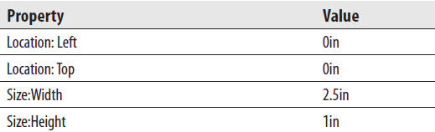
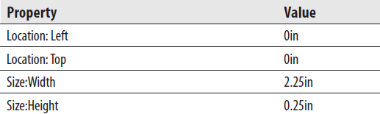
Exercise 4
Employee Mailing Labels Report, Task 1: Create the Mailing Label Content
Use the List template to place a tablix onto the body of the report. Modify the following properties of the tablix:
In the Report Data window, select the Name field and drag it onto the tablix. Select the resulting text box and set the following properties:

Slide 50
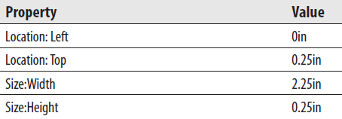
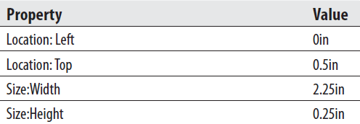
Exercise 4
Employee Mailing Labels Report, Task 1: Create the Mailing Label Content
Drag the Address1 field onto the tablix and set the following properties of the resulting text box:
Drag the CSZ field onto the tablix and set the following properties of the resulting text box:

Slide 51
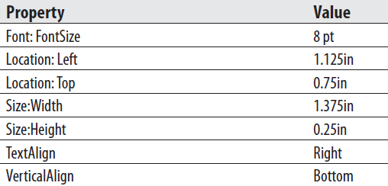
Exercise 4
Employee Mailing Labels Report, Task 1: Create the Mailing Label Content
Drag a text box onto the list and set the following properties of the text box:
Right-click the text box you just added and select Expression from the context menu. The Expression dialog box appears.
Expand the Common Functions item in the Category pane and select Miscellaneous. The Item list in the center contains the miscellaneous functions available in Reporting Services.
Double-click RowNumber in the Item list to add the RowNumber aggregate to the expression.

Slide 52

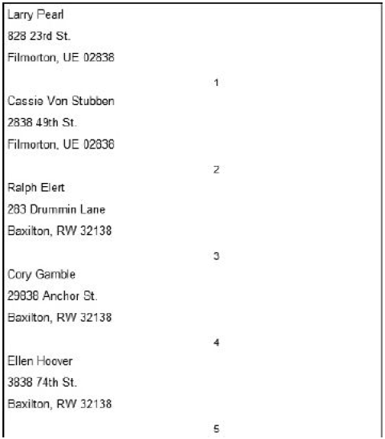
Exercise 4
Employee Mailing Labels Report, Task 1: Create the Mailing Label Content
To complete the expression, type “Tablix1”) after the (.
Click OK to exit the Expression dialog box.
Adjust the size of the tablix, if it grew during the creation of the layout.
Adjust the report body so it is exactly the same size as the tablix report item.
Preview/Run the report. Your report should appear similar to figure on the right.
Save the report.

Slide 53
Exercise 4
Employee Mailing Labels Report, Task 2: Add the Report Header and Multiple Columns
Click the Design tab.
From the main menu, select Report | Add Page Header.
Drag the Name field from the Report Data window and drop it in the page header layout area.
Position the text box created in Step 3 in the upper-left corner of the page header. Make the text box as wide as the Name, Address1, and CSZ fields in the report body. A blue alignment line will appear when these text boxes are the same width.
Drag the page header so it is only as tall as the text box you just created. This is done by clicking the dotted line between the page header and the report body and dragging upward.
Right-click the text box in the page header and select Expression from the context menu. The Expression dialog box appears.
Replace the word “First” with Count to get a count of the number of records in the dataset.
Modify the expression so it appears as follows:
="Total Employees: " & CStr(Count(Fields!Name.Value, "Employees"))
Click OK to exit the Expression dialog box.

Slide 54
Exercise 4
Employee Mailing Labels Report, Task 2: Add the Report Header and Multiple Columns
Right-click the text box in the page header and select Text Box Properties from the context menu. The Text Box Properties dialog box appears.
Select the Visibility page.
Select the Show or hide based on an expression radio button under the When the report is initially run prompt.
Click the fx button below and to the right of the radio button you just selected. The Expression dialog box appears.
Expand Common Functions in the Category pane and select Program Flow in the list on the left.
Double-click IIf in the Item pane.
Select Built-in Fields in the Category pane.
Double-click PageNumber in the Item pane.
Type > 1, true, false) at the end of the expression.
Click OK to exit the Expression dialog box.
Click OK to exit the Text Box Properties dialog box.
Click in the design window someplace outside of the report body. In the Properties window, Report will be selected at the top of the window.

Slide 55

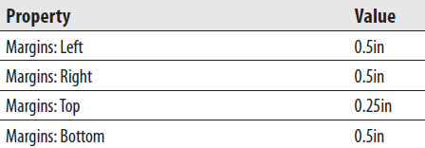
Exercise 4
Employee Mailing Labels Report, Task 2: Add the Report Header and Multiple Columns
Modify the following properties of the report:
Click anywhere in the tablix. From the main menu, select Report | Report Properties. The Report Properties dialog box appears.
Modify the following properties:
Click OK to exit the Report Properties dialog box.
Click the Preview tab, and then click the Print Layout toolbar button.
Click Save All on the toolbar.

Slide 56
The Overtime Report
Features Highlighted
Implementing cascading parameters
Using SQL stored procedures
Using table filters
Using the NoRows property
Business Need - The Galactic Delivery Services personnel department needs to monitor the amount of overtime put in at each of its repair and distribution hubs to determine when additional personnel must be hired. The personnel department needs a report that lists the employees with over 45 hours worked in a given week at a given hub. The report should have two sections. The first section should list employees with more than 45 hours and less than 55 hours worked for the selected week. The second section should list employees with more than 55 hours worked for the selected week. The user should be able to select a work week from a drop-down list, and then see a second drop-down list, showing the hubs that have one or more employees with more than 45 hours for the selected week. The user selects a hub from this second list, and then sees the report for that hub. Two stored procedures in the Galactic database should be used for retrieving data. The stp_HubsOver45 stored procedure returns a list of hubs with one or more employees who have over 45 hours worked for the selected week. The stp_EmployeesOver45 stored procedure returns a list of employees who have over 45 hours worked for the selected week at the selected hub. We discuss stored procedures in the Task Notes.
Task Overview
Create a New Report and Three Datasets.
Create the Report Layout
Add Data Bars to the Report.

Slide 57
Exercise 5
Overtime Report, Task 1: Create a New Report and Three Datasets
Reopen the Chapter08 project, if it was closed. Close the Employee Mailing Labels Report, if it is open.
Right-click Reports in the Solution Explorer and select Add | New Item from the context menu. The Add New Item dialog box appears.
Single-click GDSReport in the Templates area to select it. Change the name to Overtime and click Add.
Create a data source called “Galactic” in this new report. This new data source should reference the Galactic shared data source.
Create a dataset called “Weeks” with the following query:
SELECT DISTINCT CONVERT(char(4), DATEPART(yy,WorkDate))+'-'+
RIGHT('0'+CONVERT(varchar(2), DATEPART(wk,WorkDate)),2) as Week
FROM TimeEntry
ORDER BY Week
Right-click the Galactic entry in the Report Data window. Select Add Dataset from the context menu. The Dataset Properties dialog box appears.

Slide 58
Exercise 5
Overtime Report, Task 1: Create a New Report and Three Datasets
Enter HubsOver45 for the name in the Dataset dialog box.
Select the Stored Procedure radio button under the Query type prompt.
Select stp_HubsOver45 from the Select or enter stored procedure name dropdown list.
Click OK to exit the Dataset Properties dialog box. An entry for the HubsOver45 dataset appears in the Report Data window.
Right-click the Galactic entry in the Report Data window. Select Add Dataset from the context menu. The Dataset Properties dialog box appears.
Enter EmployeesOver45 for the name in the Dataset dialog box.
Select the Stored Procedure radio button under the Query type prompt.
Select stp_EmployeesOver45 from the Select or enter stored procedure name drop-down list.
Click OK to exit the Dataset Properties dialog box. An entry for the EmployeesOver45 dataset appears in the Report Data window.

Slide 59
Exercise 5
Overtime Report, Task 2: Create the Report Layout
Expand the Parameters entry in the Report Data window. Notice two parameters, Week and HubCode, were created automatically for us based on the parameters required by the stored procedures we selected.
Right-click the entry for the Week parameter in the Report Data window andselect Parameter Properties from the context menu. The Report Parameter Properties dialog box appears.
Select the Available Values page.
Select the Get values from a query radio button.
Select Weeks from the Dataset drop-down list. Select Week from the Value field drop-down list. Select Week from the Label field drop-down list.
Click OK to exit the Report Parameter Properties dialog box.
Right-click the entry for the HubCode parameter in the Report Data window and select Parameter Properties from the context menu. The Report Parameter Properties dialog box appears.
Change Prompt to Hub.
Select the Available Values page.
Select the Get values from a query radio button.

Slide 60
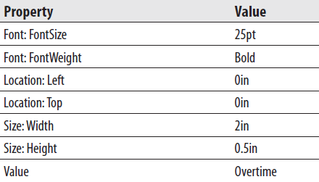
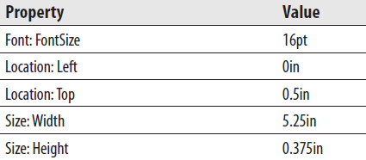
Exercise 5
Overtime Report, Task 2: Create the Report Layout
Select HubsOver45 from the Dataset drop-down list. Select HubCode from the Value field drop-down list. Select Hub from the Label field drop-down list.
Click OK to exit the Report Parameter Properties dialog box.
Place a text box onto the body of the report. Modify the following properties of this text box:
Place a second text box onto the body of the report. Modify the following properties of this text box:

Slide 61
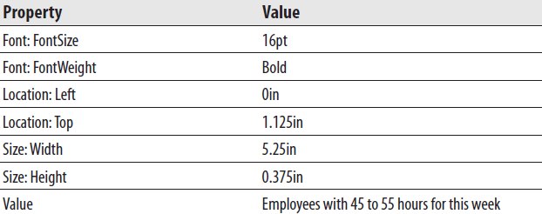
Exercise 5
Overtime Report, Task 2: Create the Report Layout
Right-click this text box and select Expression from the context menu.
Type the following in the Set expression for: Value area:
= "Week: " & Parameters!Week.Value & " Hub: " & Parameters!HubCode.Value
Click OK to exit the Expression dialog box.
Place a third text box onto the body of the report. Modify the following properties of this text box:
Use the table template to place a tablix onto the body of the report immediately below the third text box.
Place the EmployeeNumber field from the EmployeesOver45 dataset in the leftmost cell in the detail row of the tablix.

Slide 62


Exercise 5
Overtime Report, Task 2: Create the Report Layout
Place the FirstName field from the EmployeesOver45 dataset in the center cell in the detail row of the tablix.
Place the LastName field from the EmployeesOver45 dataset in the rightmost cell in the detail row of the tablix.
Drag the HoursWorked field from the EmployeesOver45 dataset in the Report Data window and use it to add a new column on the right side of the tablix.
Select the tablix header row. Modify the following property:
Select the leftmost table column. Modify the following property:
Right-click the gray box in the upper-left corner of the tablix and select Tablix Properties from the context menu. The Tablix Properties dialog box appears.
Select the Filters page.

Slide 63

Exercise 5
Overtime Report, Task 2: Create the Report Layout
Click Add to create a new filter entry.
Select [HoursWorked] from the Expression drop-down list.
Select <= from the Operator drop-down list.
Type =55 for Value.
Click OK to exit the Tablix Properties dialog box.
Modify the following property of the tablix using the Properties window:
Select both the tablix and the text box with the string “Employees with 45 to 55 hours for this week.” Press ctrl-c to copy these two report items. We are going to paste a copy of these two items and use them to create the layout for the Employees over 55 Hours.
Drag the report body larger. Do this by dragging the dashed line between the report body and the page footer.
Press ctrl-v to paste a copy of the two report items. Drag the two new items so they are below the originals.

Slide 64
Exercise 5
Overtime Report, Task 2: Create the Report Layout
Select the new text box by itself. Change the value of the text box to Employees with over 55 hours for this week.
Click anywhere in the new tablix, right-click any of the gray boxes above or to the left of the tablix and select Tablix Properties from the context menu. The Tablix Properties dialog box appears.
Select the Filters page.
Select > from the Operator drop-down list.
Click OK to exit the Tablix Properties dialog box.
Click the Preview tab.
Notice the Week drop-down list is enabled, but the Hub drop-down list is disabled. Select 2013–15 from the Week drop-down list.
Once a week is selected, the Hub drop-down list is enabled. Select Borlaron Repair Base from the Hub drop-down list. Click the View Report button.
Select 2013–10 from the Week drop-down list. Borlaron Repair Base is still selected in the Hub drop-down list. Click the View Report button. Note the text under the Employees with Over 55 Hours for This Week heading.
Click Save All on the toolbar.

Slide 65
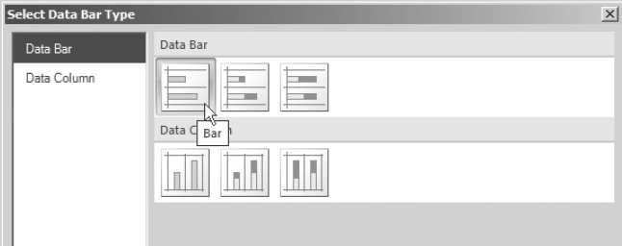
Exercise 5
Overtime Report, Task 3: Add Data Bars to the Report
Return to Design mode.
Click the Data Bar entry in the Toolbox, if you are using SSDT or Visual Studio, or on the Insert ribbon tab, if you are using Report Builder. (Just click. Do not click and drag.)
Move the mouse pointer over the design area; you will see the data bar insert cursor.
Click the cell containing “[HoursWorked]” in the detail row of the upper tablix. The Select Data Bar Type dialog box appears.
Select the Bar type style as shown in figure below.
Click OK. The text box is replaced by a data bar in this cell of the tablix.

Slide 66
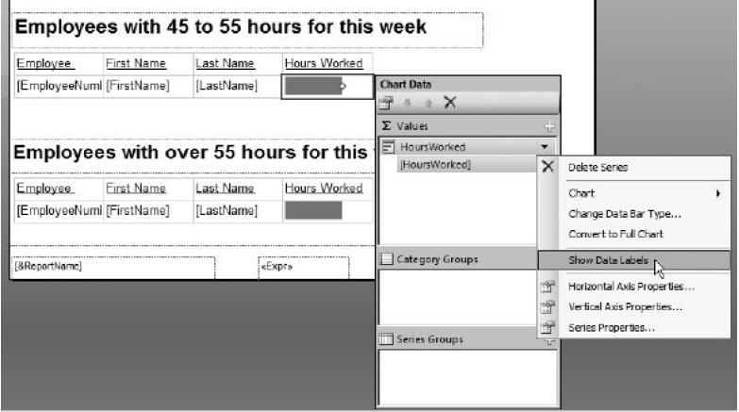
Exercise 5
Overtime Report, Task 3: Add Data Bars to the Report
Repeat Step 2 through Step 6 for the cell containing “[Hours Worked]” in the detail row of the lower tablix.
Double-click the data bar in the upper tablix. The Chart Data window appears.
In the Values pane of the Chart Data window, click the drop-down arrow next to “HoursWorked”—the upper of the two items in the Values pane.
Select “Show Data Labels” from the menu as shown in figure below.

Slide 67

Exercise 5
Overtime Report, Task 3: Add Data Bars to the Report
Click the same drop-down arrow, and select “Horizontal Axis Properties” from the menu. The Horizontal Axis Properties dialog box appears.
Modify the following properties of the Horizontal Axis using the dialog box:
Click OK to exit the Horizontal Axis Properties dialog box.
Double-click the data bar in the lower tablix. The Chart Data window appears.
In the Values pane of the Chart Data window, click the drop-down arrow next to “HoursWorked”—the upper of the two items in the Values pane.
Select “Show Data Labels” from the menu.
Click the same drop-down arrow, and select “Horizontal Axis Properties” from the menu. The Horizontal Axis Properties dialog box appears.

Slide 68
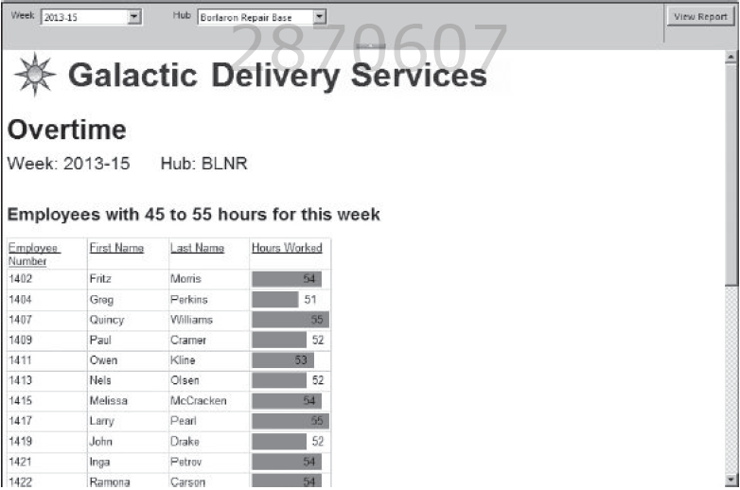
Exercise 5
Overtime Report, Task 3: Add Data Bars to the Report
Click OK to exit the Horizontal Axis Properties dialog box.
Preview/Run the report.
Select 2013–15 from the Week drop-down list.
Select Borlaron Repair Base from the Hub drop-down list. Click the View
Report button. Your report should appear similar to figure below.
Save the report.

Slide 69
The Revised Employee Time Report
Features Highlighted
Implementing fixed and dynamic columns and rows in the same tablix
Using the Switch() function
Business Need - The Galactic Delivery Services personnel department is finding the Employee Time Report to be useful. To make the report even more useful, they would like to add summary information to the report. To the right of the current report, they would like to summarize the hours worked by the day of the week—in other words, how many hours were put in on Mondays, Tuesdays, Wednesdays, etc. They would like a summary of the hours worked at each delivery hub specified by hub code. Finally, at the bottom of the report, they would like a summary of the hours worked by job type. Our database does not contain a definition of job type. Job type is an ad hoc classification that the personnel department uses for some analysis. All levels of mechanics, both I and II, form one job type. All levels of sorters, both I and II, form a second job type, while transport pilots and transport co-pilots make up the third job type.
Task Overview
Copy and Rename the Existing Report
Modify the Dataset and the Layout.

Slide 70
Exercise 6
Revised Employee Time Report, Task 1: Copy and Rename the Existing Report, Modify the Dataset, Modify Layout
Reopen the Chapter07 project, if it was closed. Close the Overtime Report, if it is open.
Right-click the EmployeeTime Report in the Solution Explorer and select Copy from the context menu.
Right-click the Chapter07 project in the Solution Explorer and select Paste from the context menu. A copy of the report appears in the Solution Explorer.
Right-click this new copy and select Rename from the context menu. Rename the report RevisedEmployeeTime.rdl.
Double-click the entry for the RevisedEmployeeTime report to open this report for editing.
In the Report Data window, right-click EmployeeTime and select Query from the context menu. The Query Designer window opens.
Add the HubCode field to the end of the field list, as shown here:
SELECT Description AS Job, Employee.EmployeeNumber,
FirstName, LastName, CONVERT(char(4),
DATEPART(yy, WorkDate))+'-'+ CONVERT(char(2),
DATEPART(wk, WorkDate)) AS Week, WorkDate, HoursWorked, HubCode
FROM TimeEntry
INNER JOIN Assignment
ON TimeEntry.AssignmentID = Assignment.AssignmentID
INNER JOIN Employee
ON Assignment.EmployeeNumber = Employee.EmployeeNumber
INNER JOIN Job
ON Assignment.JobID = Job.JobID
ORDER BY Job, Employee.EmployeeNumber, Week, WorkDate

Slide 71
Exercise 6
Revised Employee Time Report, Task 1: Copy and Rename the Existing Report, Modify the Dataset, Modify Layout
Run the query to make sure no errors exist. Correct any typos that may be detected.
Click OK to exit the Query Designer window.
Right-click in the bottom row of the tablix. Select Tablix: Insert Row | Below from the context menu. A new static row is added at the bottom of the tablix.
Right-click in the row you just added and select Tablix: Add Group | Row Group : Adjacent Below from the context menu. The Tablix group dialog box appears.
Select [HubCode] from the Group by drop-down list.
Click OK to exit the Tablix group dialog box. A new row group is added at the bottom of the tablix.
Merge the leftmost three cells in the bottom row of the tablix.
Select the HubCode field in the newly merged cells.
Merge all of the cells in the second-from-the-bottom row in the tablix.

Slide 72
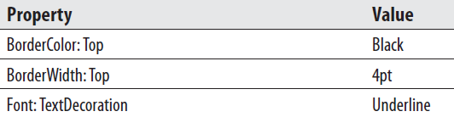

Exercise 6
Revised Employee Time Report, Task 1: Copy and Rename the Existing Report, Modify the Dataset, Modify Layout
Set the following properties of this newly merged cell:
In the cell in the lower-right corner of the tablix, select the HoursWorked field. This field will automatically be enclosed in a Sum() aggregate function.
Set the following property of this cell:
Click the Preview tab.
Click the Design tab.
Right-click in the bottom row of the tablix. Select Tablix: Insert Row | Outside Group - Below from the context menu. A new static row is added at the bottom of the tablix.

Slide 73
Exercise 6
Revised Employee Time Report, Task 1: Copy and Rename the Existing Report, Modify the Dataset, Modify Layout
Right-click in the row you just added and select Tablix: Add Group | Row Group: Adjacent Below from the context menu. The Tablix group dialog box appears.
Click the Expression button next to the Group by drop-down list. The Expression dialog box appears.
Enter the following in the Set expression for: GroupExpression area:
=Switch(LEFT(Fields!Job.Value, 8) = "Mechanic", "Mechanics",
LEFT(Fields!Job.Value, 6) = "Sorter", "Sorters",
LEFT(Fields!Job.Value, 9) = "Transport", "Pilots")
Highlight the entire expression you just entered and press ctrl-c to copy this text.
Click OK to exit the Expression dialog box.
Click OK to exit the Tablix group dialog box. A new row group is added at the bottom of the tablix.
Merge the leftmost three cells in the bottom row of the tablix.
Right-click in the newly merged cells and select Textbox: Expression from the context menu. The Expression dialog box appears.

Slide 74
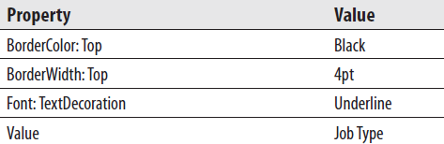
Exercise 6
Revised Employee Time Report, Task 1: Copy and Rename the Existing Report, Modify the Dataset, Modify Layout
Delete the equals sign from the Set expression for: Value area and press CTRL-V to paste the expression you entered in Step 25.
Click OK to exit the Expression dialog box.
Merge all of the cells in the second-from-the-bottom row in the tablix.
Set the following properties of this newly merged cell:
In the cell in the lower-right corner of the tablix, select the HoursWorked field. This field will automatically be enclosed in a Sum() aggregate function.
Click the Preview tab.
Click the Design tab.

Slide 75
Exercise 6
Revised Employee Time Report, Task 1: Copy and Rename the Existing Report, Modify the Dataset, Modify Layout
Right-click in the rightmost column in the tablix and select Tablix: Insert Column | Right from the context menu. A new column is added to the right of the tablix.
Size the new column so it is approximately one-fourth its original width.
Right-click in the new column and select Tablix: Add Group | Column Group: Adjacent Right from the context menu. The Tablix group dialog box appears.
Click the Expression button next to the Group by drop-down list. The Expression dialog box appears.
Expand the Common Functions entry in the Category pane. Select the Date & Time entry in the Category pane. Double-click the Weekday entry in the Item pane.
Select Fields (EmployeeTime) in the Category pane. Double-click the WorkDate field in the Field pane.
Type ) at the end of the expression.

Slide 76
Exercise 6
Revised Employee Time Report, Task 1: Copy and Rename the Existing Report, Modify the Dataset, Modify Layout
Click OK to exit the Expression dialog box.
Click OK to exit the Tablix group dialog box. A new column group is added at the right of the tablix.
Right-click the upper cell in the new column and select Textbox: Expression from the context menu. The Expression dialog box appears.
Expand the Common Functions entry in the Category pane. Select the Date & Time entry in the Category pane. Double-click the WeekdayName entry in the Item pane.
Double-click the Weekday entry in the Item pane.
Select Fields (EmployeeTime) in the Category pane. Double-click the WorkDate field in the Field pane.
Type )) at the end of the expression.
Click OK to exit the Expression dialog box.
Select the HoursWorked field in each of the three cells below the cell you just modified. In each case, the field will be enclosed in a Sum( ) aggregate function.

Slide 77

Exercise 6
Revised Employee Time Report, Task 1: Copy and Rename the Existing Report, Modify the Dataset, Modify Layout
Click the gray rectangle at the top of the second column from the right (the narrow column) to select the entire column. Modify the following property:
Click the Preview tab.
Click Save All on the toolbar.

Slide 78
The Revised Employee List Report
Features Highlighted
Using the Lookup function
Using the LookupSet function
Using the MultiLookup function
Using the Join function
Using the Split function
Business Need - As with the Employee Time Report, the Galactic Delivery Services personnel department likes the Employee List Report. To add to its functionality, they would like to add information about the total hours worked by each employee. They would also like to see the levels of education for other employees at the hub where the employee works and the highest level of education for each union the employee is a member of. We could modify our existing query for this report or create a complex stored procedure to gather and return all of these items. Instead, we are going to make use of some existing stored procedures that return the data required. These additional stored procedures will each have their own dataset in the report. It is not possible to join data between two datasets in a report. What we can do instead is use the Lookup functions in Reporting Services to look up a value from one dataset and find related information in another dataset.
Task Overview
Copy and Rename the Existing Report, Add Datasets, and Utilize the Lookup Functions

Slide 79
Exercise 7
Revised Employee List Report, Task 1: Copy and Rename the
Existing Report, Add Datasets, and Utilize the Lookup Functions
Copy the EmployeeList Report the same way you copied the EmployeeTime Report in the previous exercise. Name the copy of the report RevisedEmployeeList.rdl. Double-click the RevisedEmployeeList report to edit it.
In the Report Data window, expand the Data Sources folder.
Right-click the entry for the Galactic data source, and select Add Dataset from the context menu. The Dataset Properties dialog box appears.
Enter TotalHours for Name.
Select the Stored procedure radio button.
Select stp_TotalHoursWorked from the Select or enter stored procedure name drop-down list.
Click OK to exit the Dataset Properties dialog box.
Right-click the entry for the Galactic data source, and select Add Dataset from the context menu. The Dataset Properties dialog box appears.
Enter EdByHub for Name.
Select the Stored procedure radio button.
Select stp_EducationByHub from the Select or enter stored procedure name drop-down list.

Slide 80
Exercise 7
Revised Employee List Report, Task 1: Copy and Rename the
Existing Report, Add Datasets, and Utilize the Lookup Functions
Click OK to exit the Dataset Properties dialog box.
Right-click the entry for the Galactic data source, and select Add Dataset from the context menu. The Dataset Properties dialog box appears.
Enter EdByUnion for Name.
Select the Stored procedure radio button.
Select stp_HighestEdByUnion from the Select or enter stored procedure name drop-down list.
Click OK to exit the Dataset Properties dialog box.
Scroll through the Design area to the right side of the table.
Right-click anywhere in the rightmost column of the table, and select Tablix | Insert Column | Right from the context menu.
Enter Total Hours in the topmost cell of this new column.
Right-click the bottom-most cell of this new column, and select Expression from the context menu. The Expression dialog box appears.
Enter the following in the Set expression for: Value area:
=Lookup(Fields!EmployeeNumber.Value, Fields!EmployeeNumber.Value, Fields!TotalHoursWorked.Value, "TotalHours")

Slide 81
Exercise 7
Revised Employee List Report, Task 1: Copy and Rename the
Existing Report, Add Datasets, and Utilize the Lookup Functions
Click OK to exit the Expression dialog box.
Right-click anywhere in the rightmost column of the table, and select Tablix | Insert Column | Right from the context menu.
Enter Educ. for Hub in the topmost cell of this new column.
Right-click the bottom-most cell of this new column, and select Expression from the context menu. The Expression dialog box appears.
Enter the following in the Set expression for: Value area:
=Join(LookupSet(Fields!Hub.Value, Fields!Hub.Value,
Fields!HighestLevelOfEducation.Value, "EdByHub"), ", ")
Be sure to include a space after each comma, including the comma in quotes.
Click OK to exit the Expression dialog box.
Right-click anywhere in the rightmost column of the table, and select Tablix | Insert Column | Right from the context menu.
Enter Educ. for Union in the topmost cell of this new column.

Slide 82
Exercise 7
Revised Employee List Report, Task 1: Copy and Rename the
Existing Report, Add Datasets, and Utilize the Lookup Functions
Right-click the bottom-most cell of this new column, and select Expression from the context menu. The Expression dialog box appears.
Enter the following in the Set expression for: Value area:
=Join(MultiLookup(Split(Fields!UnionMembership.Value, ", "),
Fields!UnionMembership.Value, Fields!HighestLevelOfEducation.Value, "EdByUnion"), ", ")
Be sure to include a space after each comma, including the commas in quotes.
Click OK to exit the Expression dialog box.
Preview/Run the report
Save the report.

Slide 83
Under the Hood
RDL was created by Microsoft specifically for Reporting Services. It was one of the first published Extensible Markup Language (XML) document standards created by Microsoft.
Microsoft has gone public with the specifications for RDL. Third parties can create their own authoring environments for creating report definitions.
If the RDL from these third-party tools conforms to the RDL standard, the reports created by these tools can be managed and distributed by Reporting Services.

Slide 84
Viewing the RDL
Right-click the entry for Overtime.rdl in the Solution Explorer, and then select View Code from the context menu.
You see a new tab in the layout area called Overtime.rdl.
This tab contains the actual RDL of the report, as shown in figure below.

Slide 85
Editing the RDL
One other interesting thing about viewing the RDL in the Report Builder is you can make changes to the RDL and have them affect the report design.
Use the text find capabilities of this RDL editor to find the “ReportParameters” section of the RDL.
If you do find a reason to make modifications directly to the RDL, do so with care.
If you break up a begin/end pair or enter an invalid value for a property element (such as puce for a color), you can end up with a report that will not load in the Report Designer. Save your work immediately before making changes directly to the RDL.

Slide 86
Editing the RDL
One other interesting thing about viewing the RDL in the Report Builder is you can make changes to the RDL and have them affect the report design.
Use the text find capabilities of this RDL editor to find the “ReportParameters” section of the RDL.
If you do find a reason to make modifications directly to the RDL, do so with care.
If you break up a begin/end pair or enter an invalid value for a property element (such as puce for a color), you can end up with a report that will not load in the Report Designer. Save your work immediately before making changes directly to the RDL.

